Slide 1

School network system
School Network Diagram

Slide 2
Content
INTRODUCTION
BACKGROUND
EXISTING SYSTEM
PROBLEMs AND WEAKNESS
AIM
OBJECTIVE
BENEFITS TO THE school
INFORMATION GATHERING METHOD
BUILDING PLAN
NETWORK DESIGN
RESOURCE REQUIREMENT
PROJECT SCHEDULE

Slide 3
INTRODUCTION
The school doesn't have a network system, they both don’t have the resources needed to keep pace and updated with technology, Internet-based learning materials, and communication between staff and students. This prosses will take lot of time and the effected. Because of that we decided to make them a real reliable computer network system and we made clear simple solutions to the students, staff members and whole school for a secure network system.

Slide 4
BACKGROUND
We have chosen Ihala Beligalla Maha Vidyalaya located at Beliatta in Sri Lanka. There are classes from 6 to 13 and 500 students are learning in this school. There are a total of 18 desktop computers and a printer in the computer lab. 16 computers are allocated for the students and 2 computers allocated for the staff among the above computers. Two additional computers, a printer, and a photocopy machine are available in the office. the computers of this school are not networked, they both don’t have the resources needed to keep pace and updated with technology, Internet-based learning materials, and communication between staff and student.

Slide 5
EXISTING SYSTEM
Schools can operate without a network system, but it would be difficult to achieve the same level of efficiency and effectiveness as schools with network systems. Here are some of the challenges that schools may face without a network system:
Limited communication
Limited access to online resources
Limited security

Slide 6
PROBLEMs AND WEAKNESS
Resources cannot be shared with staff members and students.
Official information is not secure.
Time consumes.
Human mistakes may occur.
Document sharing is pricey and extremely sluggish.
Limited access to distance learning

Slide 7
AIM
The network system enables students, teachers, and staff to communicate with each other easily and quickly.
The network system can provide access to online resources, multimedia content, and educational software.
The network system can help schools streamline administrative tasks, such as record-keeping, student information management, and financial management.
The network system can help schools protect sensitive data and prevent unauthorized access.

Slide 8
OBJECTIVE
the objectives of a network system for a school are to improve communication, enhance learning outcomes, streamline administrative processes, improve data management, provide access to distance learning, enhance security, increase efficiency and productivity, and improve collaboration. By achieving these objectives, schools can provide the best possible education for their students and improve overall school operations.

Slide 9
BENEFITS TO THE school
• Enhancing the effectiveness of administrative tasks.
• Improved data management.
• Connecting the entire network to one internet.
• Transmission of data and information is standardized.

Slide 10
INFORMATION GATHERING METHOD
We researched the necessary topics, including network type, servers, operating systems, and other strategies.
Obtain consent for the proposed network.
And get help of internet learning resources

Slide 11
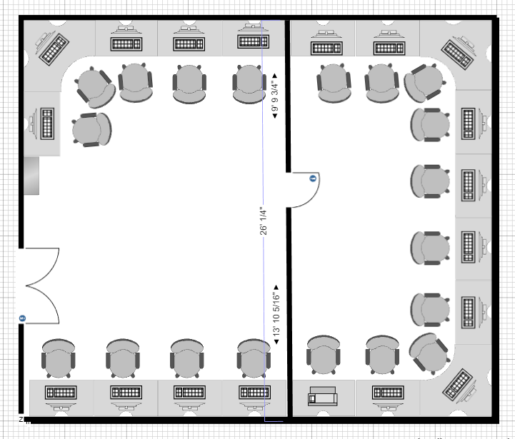
BUILDING PLAN

Slide 12
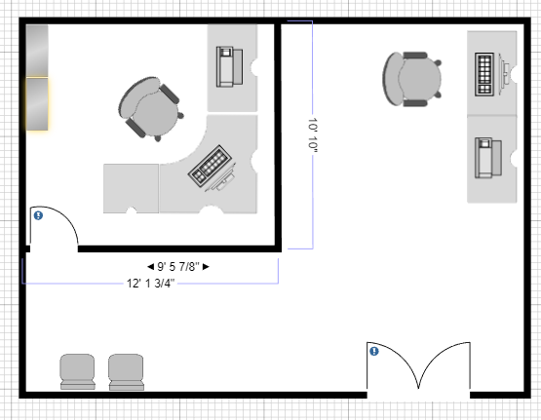

Slide 13
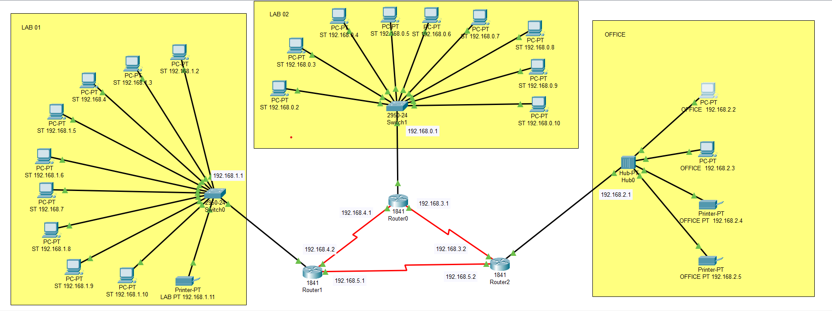
NETWORK DESIGN

Slide 14
RESOURCE REQUIREMENT
Object | Specification | Quantity
Switch | Cisco 2950 - 24 | 2
Router | Cisco 1841 | 3
Hub | Cisco Hub-PT | 1
Connectors | RJ45 | 60
Network Casing | Polycrome | 1000FT
Wall plug/anchor | Size 10
Printers | PIXMA G2020 | 3
Flexible Wire |  | 500FT
Quad shield Wire | 3in1 copper cctv wire | 500FT
ECONOMIC FEASIBILITY
Approximately 0.6 to 1 million
TECHNICAL FEASIBILITY

Slide 15
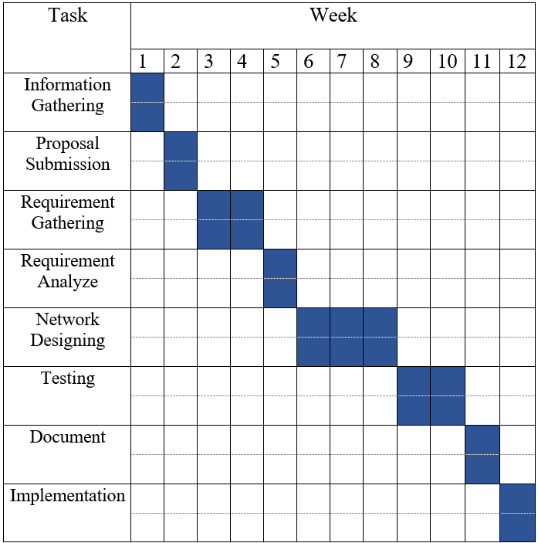
PROJECT SCHEDULE
Time framework uses to determine the start and end date of the project and its activities.

Slide 16
REFERENCES
https://youtu.be/o3SEqMJEUKw
https://youtu.be/YZRQpZPp4E4
https://youtu.be/E_EnH5DCHA8
https://youtu.be/o3SEqMJEUKw
https://youtu.be/XQUF-fOXa3k
https://youtu.be/Oj3nFRphDgw
https://youtu.be/DfaN-YTDNyE
https://youtu.be/MPTrbFzIn0Y
https://youtu.be/HWZ6_Z8bi2c
https://youtu.be/JBxlOaDis8s
https://youtu.be/U2Z61gkYoFs
https://youtu.be/0PoZA0r-r5c

Slide 17
MEMBERS
M.L.N.J. Rahul Kumara GAL/IT/2020/F/0053
S. Dimuthu Lanka GAL/IT/2020/F/0062
K. Lasith Lahiru Madushan GAL/IT/2020/F/0064
E.P. Ishan Charuka Bandara GAL/IT/2020/F/0071
K.K.G. Ishani Chathumini GAL/IT/2020/F/0090

Slide 18


